Slide 1
Data pipeline from Front Office to Data Lake

Slide 2










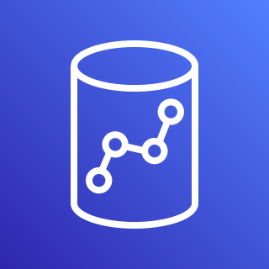

L Transformer
Athena
DynamoDB Audit Table
1 min
Step 1
S3 bucket
(staging area)
K data stream
K delivery stream
SQS Lnd Q
L G ETL + Audit entries
G Spark ETL
1 min
Step 2
5 min
S3 bucket
(landing area)
0 min
Data Source
EB Rule
L -> Lambda
K -> Kinesis
Lnd -> Landing Area
Stg -> Staging Area
Crw -> Crawler
Trg -> Trigger
G -> Glue
EB -> EventBridge
Data Source
L Data Publisher
L Data Consumer
G Workflow
API Gateway
G Stg Crw
G Python Shell
G Spark ETL
Job bookmark
DynamoDB Data Table
Redshift
Capture Order Details (UI)

Slide 3
Notes:
In the Glue Workflow, the first job – Glue Spark ETL job – loads the Redshift staging table from S3 staging area (with Job bookmark enabled) and the second job – Glue Python Shell job – performs data enrichment and “Upsert” into the Redshift final table.
For the Glue Workflow, the Trigger is the EventBridge Rule but the data source is the S3 Staging area.
Glue Crawler is setup to run on the S3 Staging area.
So staging area is available for raw data analysis (before data enrichment) through Athena.

